Slide 1
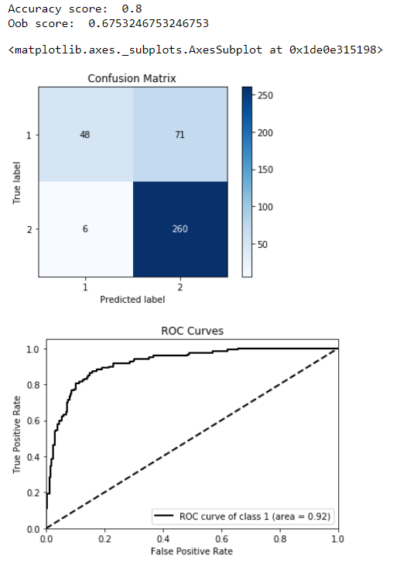
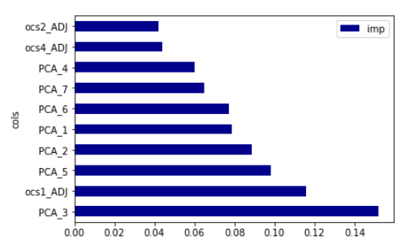
Model with all observation + PCA
Accuracy(Train set) = 80%
Accuracy(Validation Set) = 68%
Feature Importance (Top5)
PCA3
OCS1
PCA5
PCA2
PCA1
PCA6

Slide 2
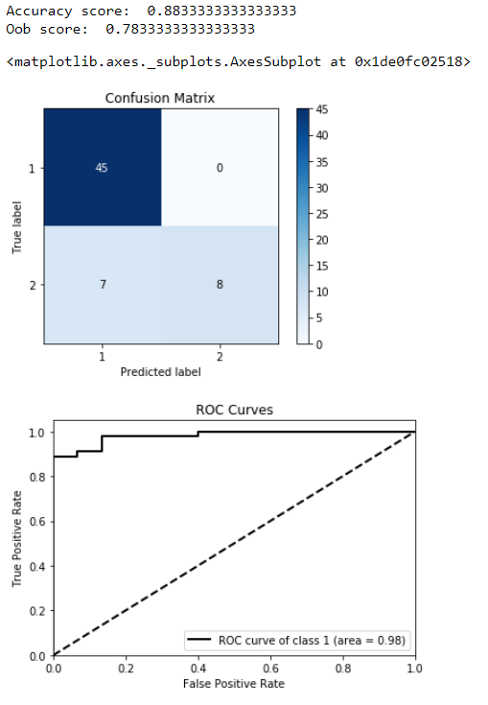
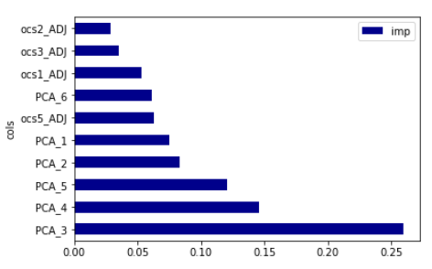
Model of Existing member + PCA
Accuracy(Train set) = 88%
Accuracy(Validation Set) = 78%
Feature Importance (Top5)
PCA3
PCA4
PCA5
PCA2
PCA1

Slide 3
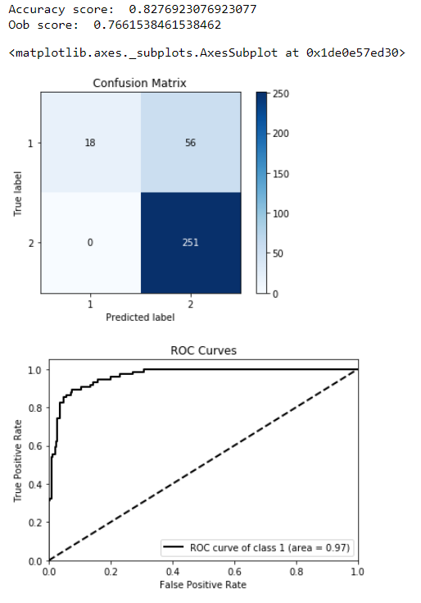
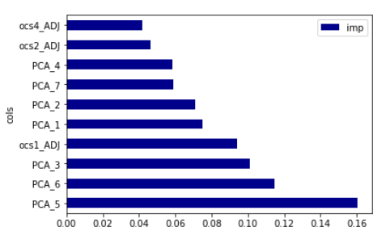
Model of non-member + PCA
Accuracy(Train set) = 83%
Accuracy(Validation Set) = 77%
Feature Importance (Top5)
PCA5
PCA6
PCA3
OCS1
PCA1

